Slide 1
Fill in the Missing Ck Words
Each of the sentences on the next slides have a word missing that contains the ‘ck’ digraph. Fill in the missing word to complete each sentence. We’ve provided answers on the last slide.

Slide 2
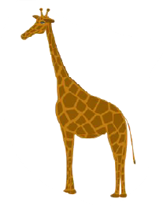

Slide 3
