Slide 1
Find the Ch Words
Ask students to identify the images that represent words containing the ch digraph and circle them. Then try to spell each of the ‘ch’ words that are appropriate for the students’ stage of phonics development. We’ve printed the answers on the last slide.

Slide 2
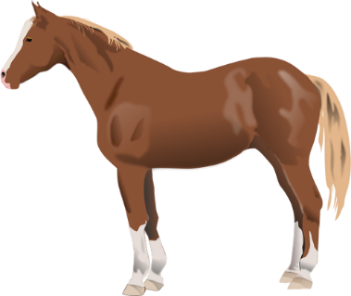
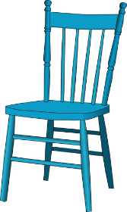
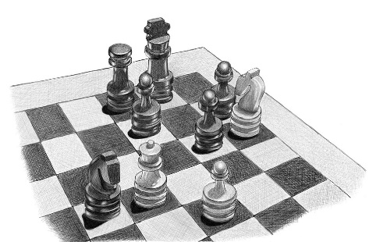
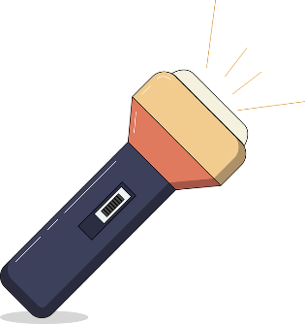

Slide 3
Answers: chair, chess, chin, chemist, peach, chimp, chef, torch

