Slide 1
a | b | c | d | e | f
g | h | i | j | k | l
m | n | o | p | qu | r
s | t | u | v | w | x
y | z

Slide 2
a

Slide 3
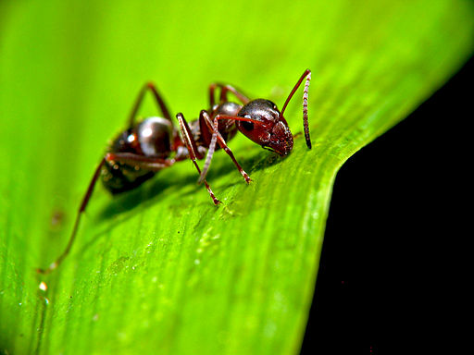
ant

Slide 4
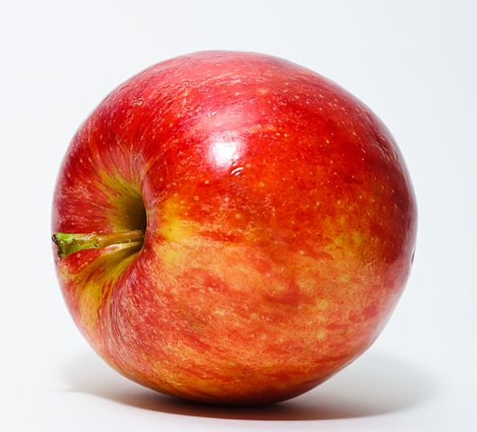
apple

Slide 5
b

Slide 6
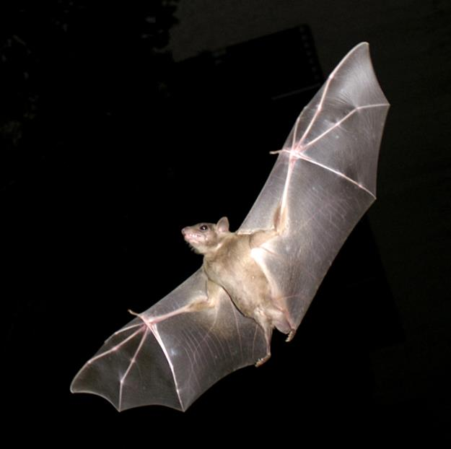
bat

Slide 7
ball

Slide 8
c

Slide 9
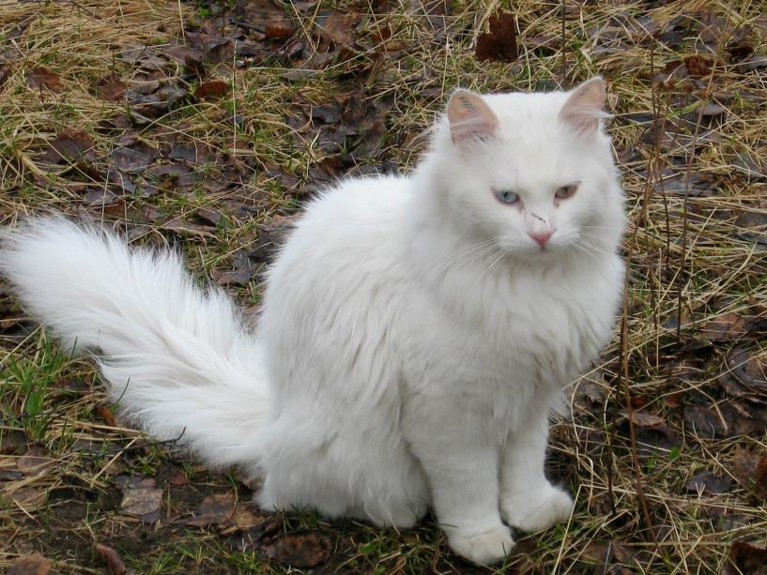
cat

Slide 10
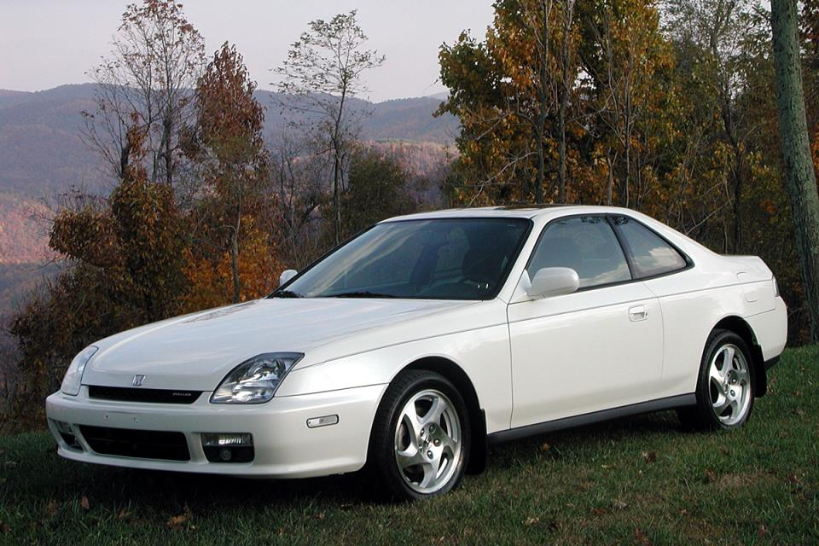
car

Slide 11
d

Slide 12
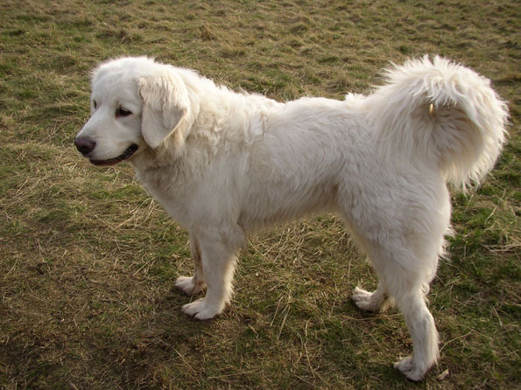
dog

Slide 13
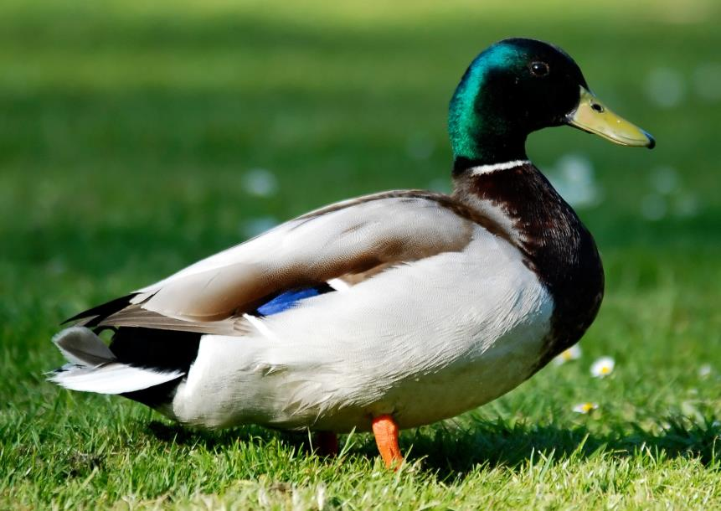
duck

Slide 14
e

Slide 15
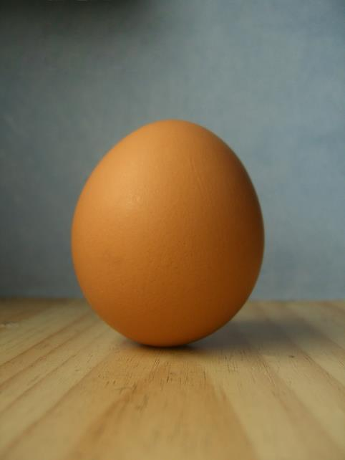
egg

Slide 16
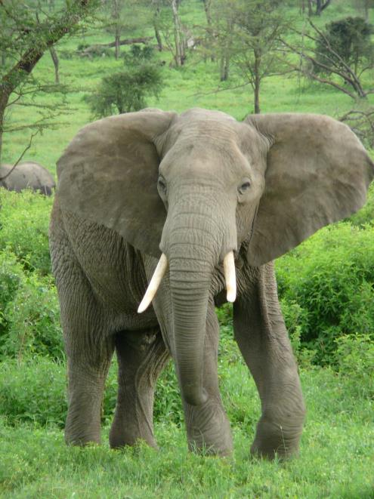
elephant

Slide 17
f

Slide 18
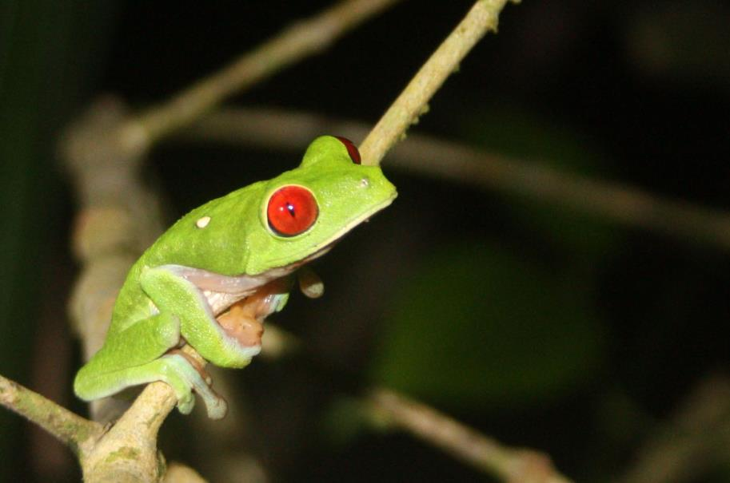
frog

Slide 19
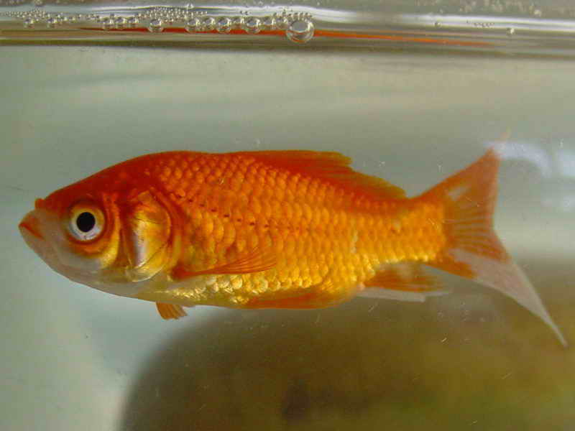
fish

Slide 20
g

Slide 21
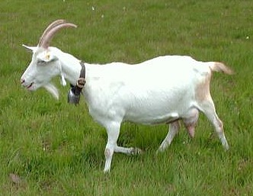
goat

Slide 22
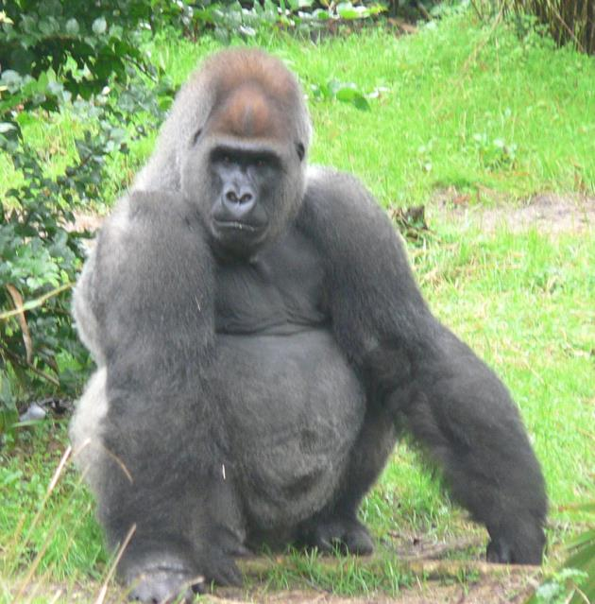
gorilla

Slide 23
h

Slide 24
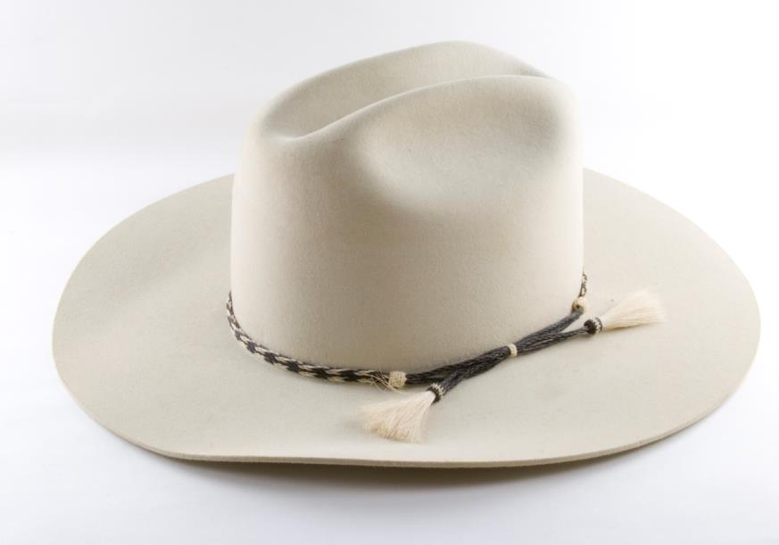
hat

Slide 25
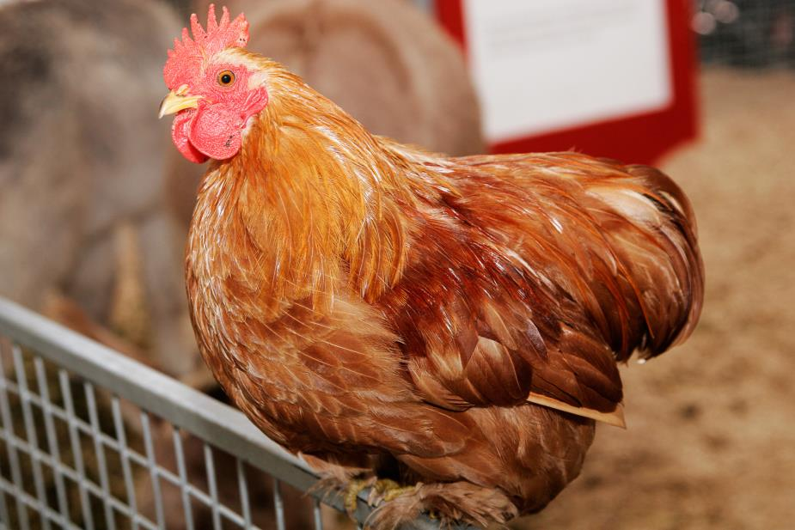
hen

Slide 26
i

Slide 27
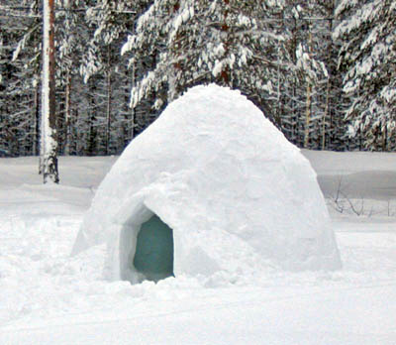
igloo

Slide 28
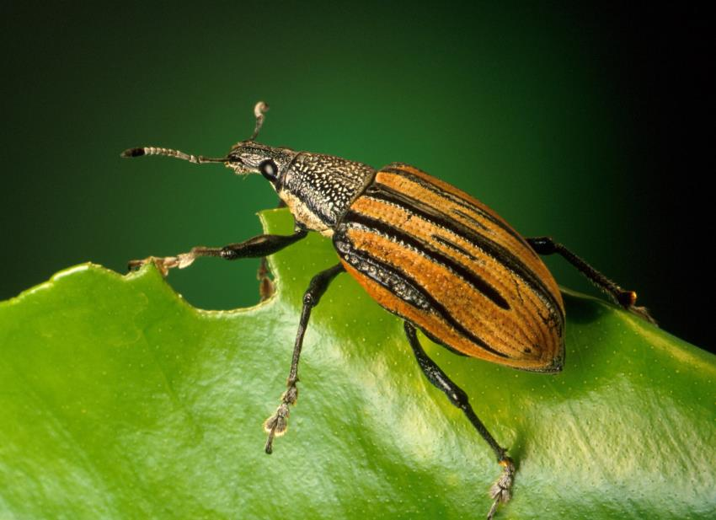
insect

Slide 29
j

Slide 30
jug

Slide 31
juice

Slide 32
k

Slide 33
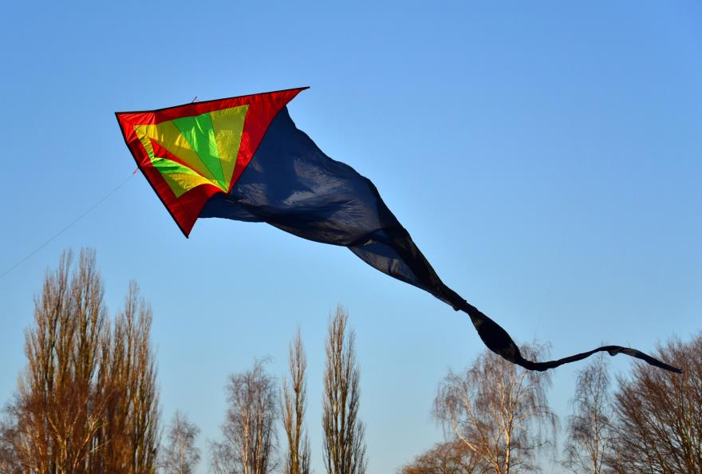
kite

Slide 34
key

Slide 35
l

Slide 36
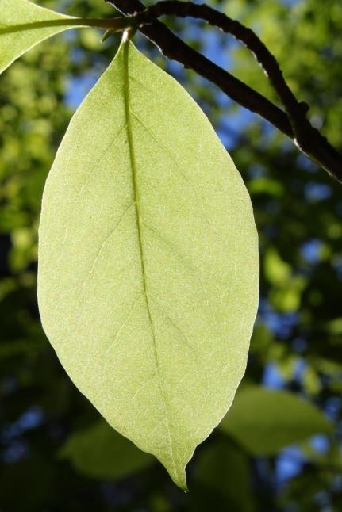
leaf

Slide 37
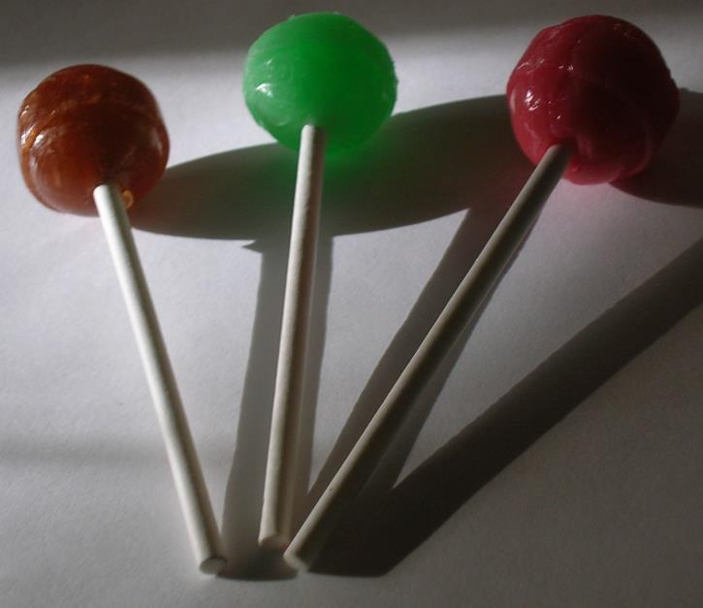
lollipops

Slide 38
m

Slide 39
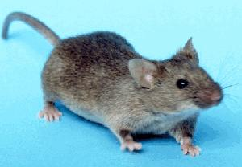
mouse

Slide 40
mermaid

Slide 41
n

Slide 42
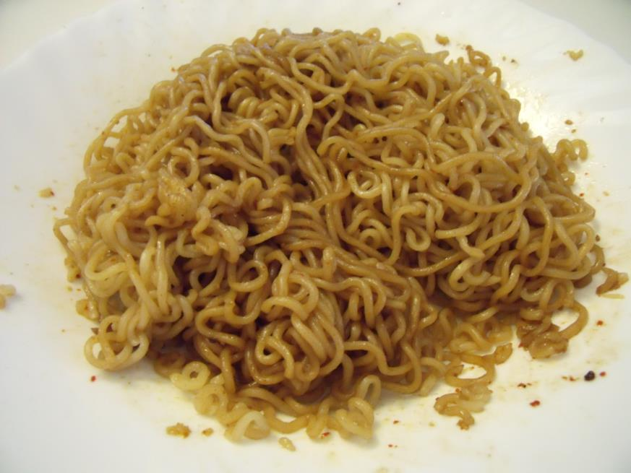
noodles

Slide 43
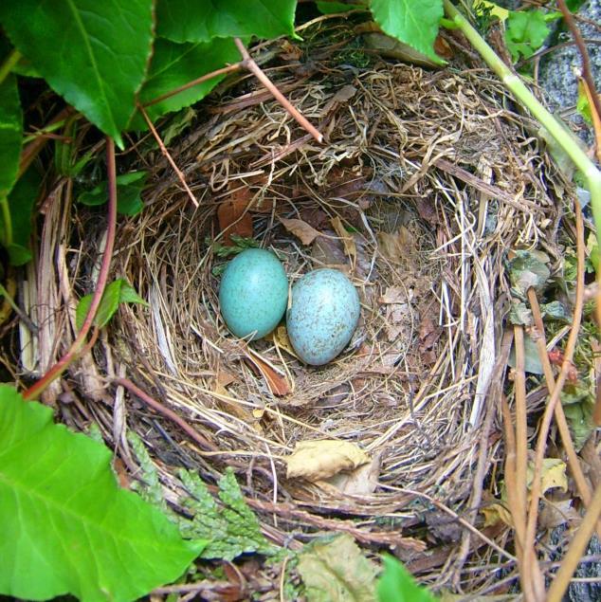
nest

Slide 44
o

Slide 45
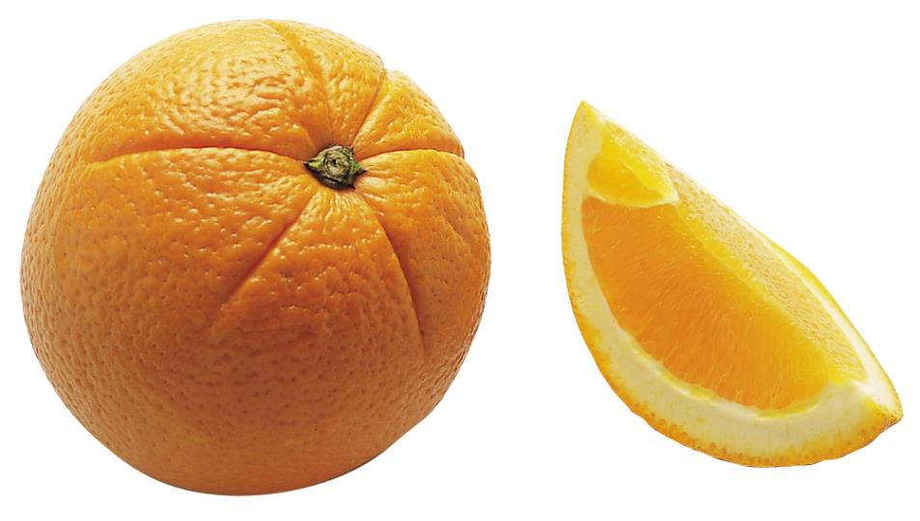
orange

Slide 46
octopus

Slide 47
p

Slide 48
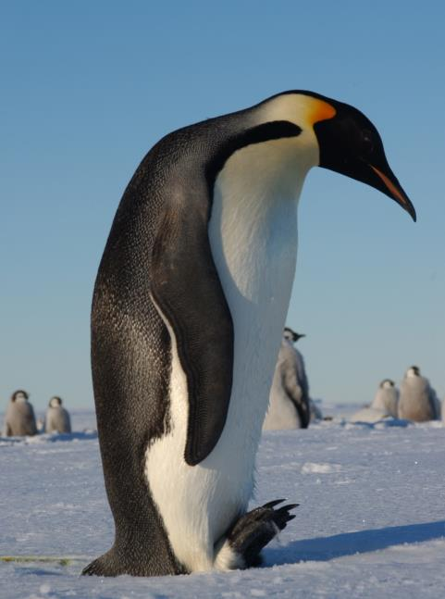
penguin

Slide 49
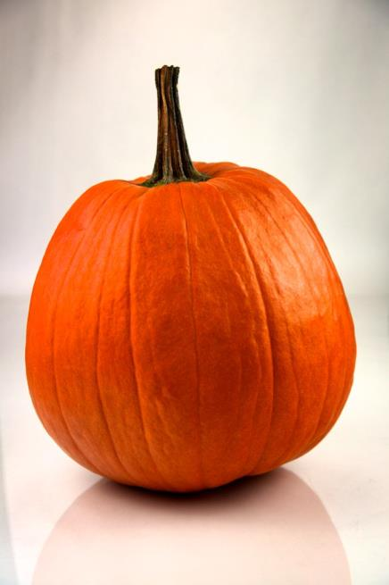
pumpkin

Slide 50
qu

Slide 51
queen

Slide 52
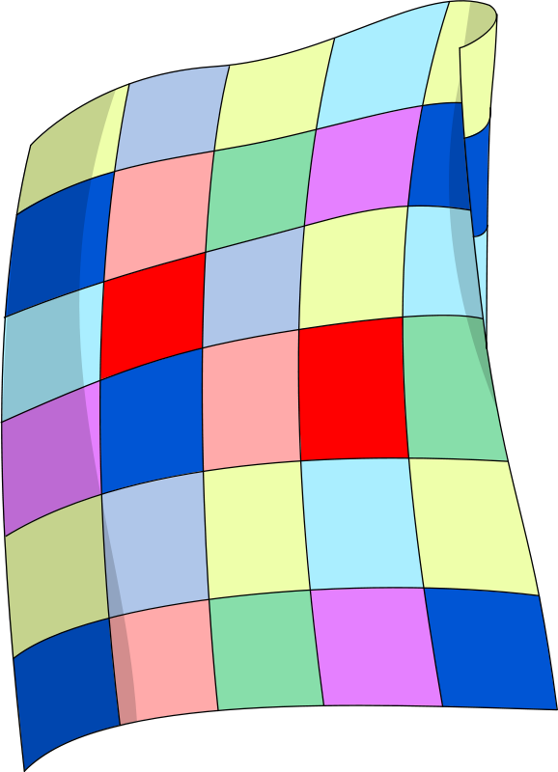
quilt

Slide 53
r

Slide 54
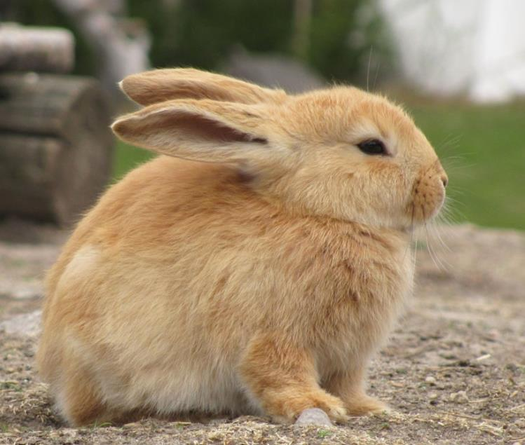
rabbit

Slide 55
rocket

Slide 56
s

Slide 57
snake

Slide 58
star

Slide 59
t

Slide 60
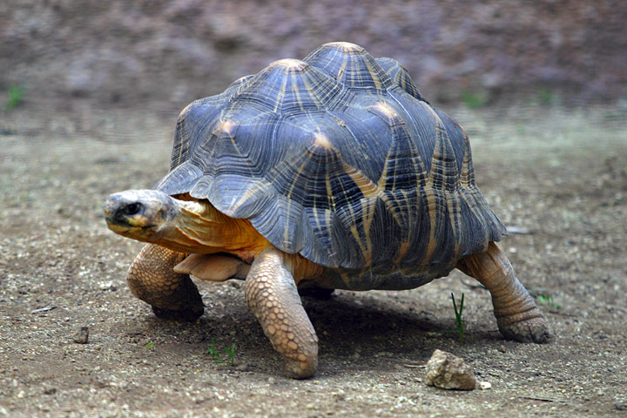
tortoise

Slide 61
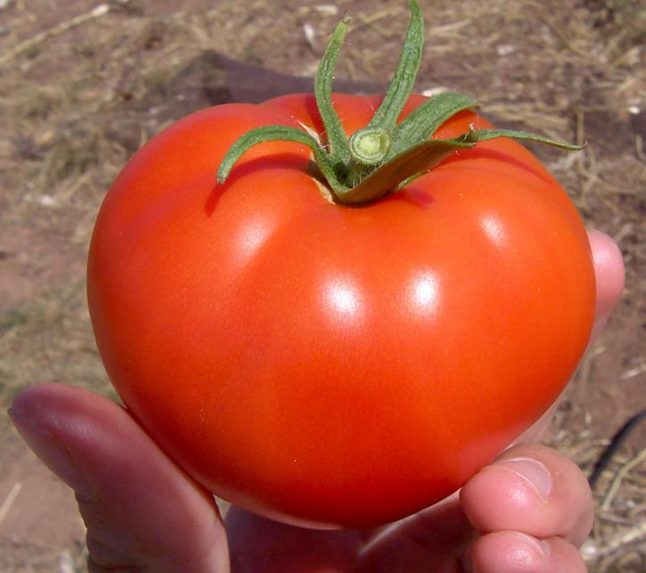
tomato

Slide 62
u

Slide 63
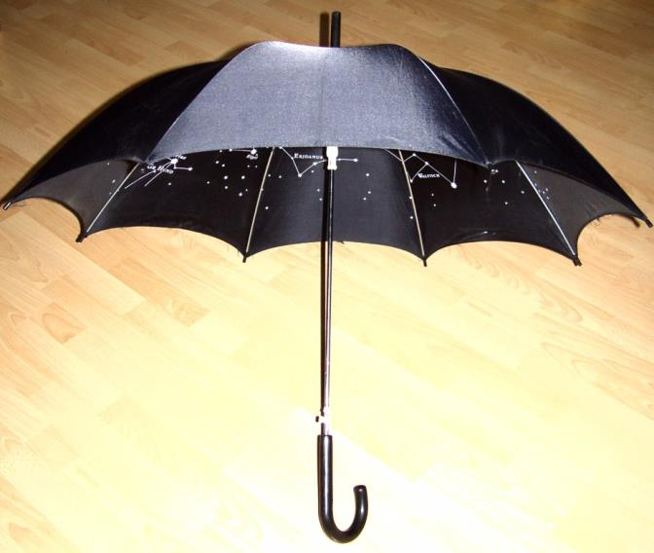
umbrella

Slide 64
up

Slide 65
v

Slide 66
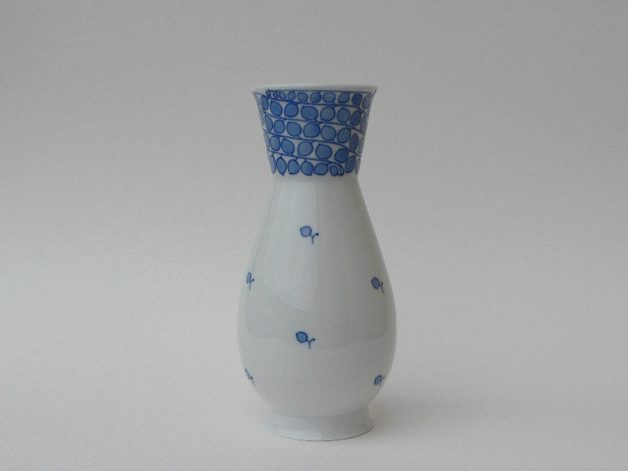
vase

Slide 67
volcano

Slide 68
w

Slide 69
worm

Slide 70
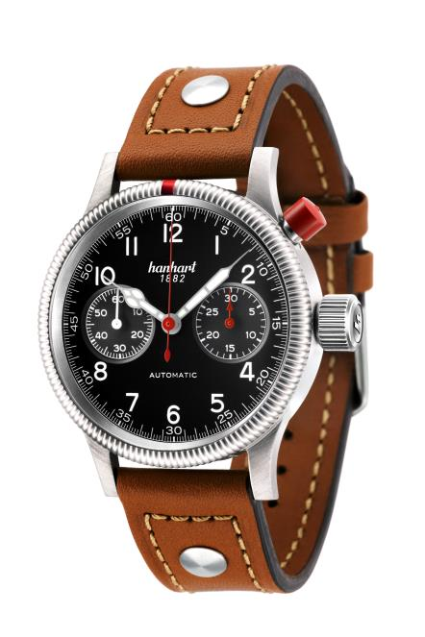
watch

Slide 71
x

Slide 72
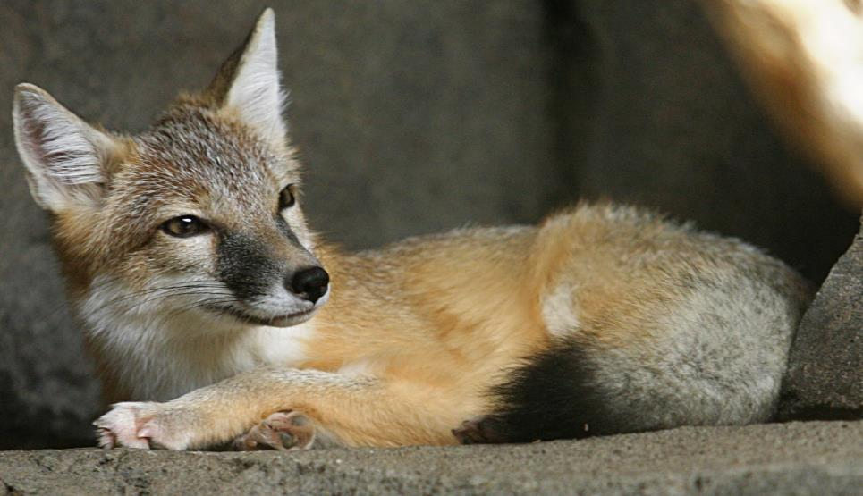
fox

Slide 73
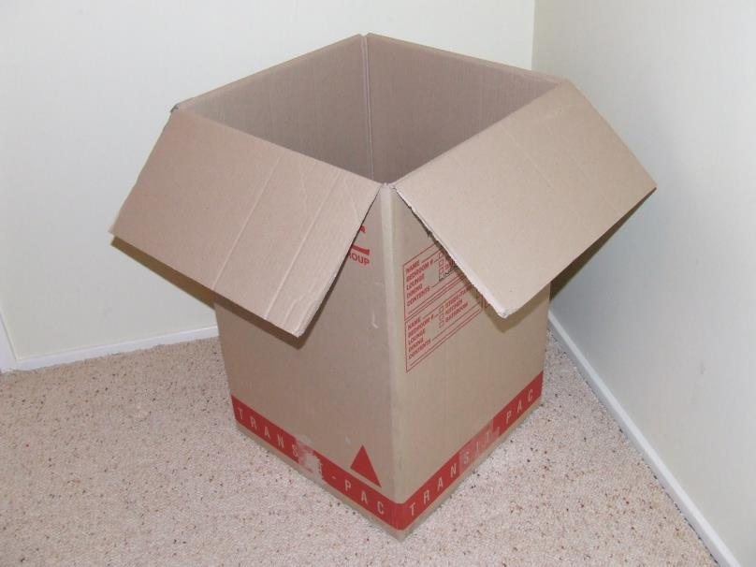
box

Slide 74
y

Slide 75
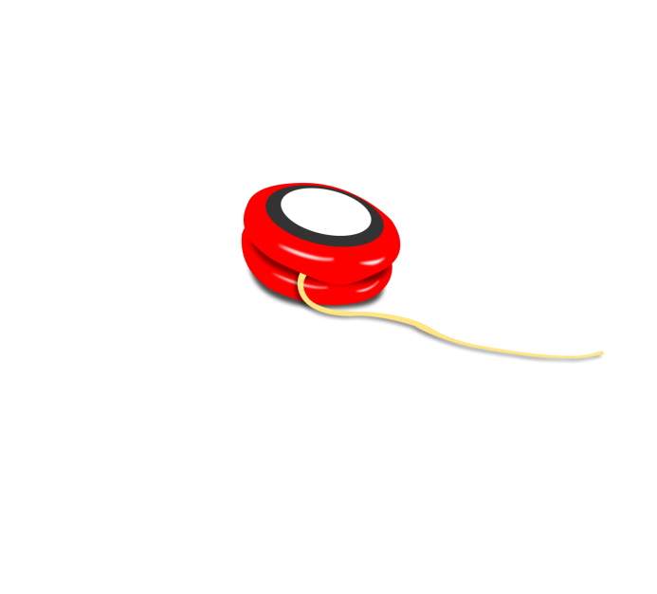
yo-yo

Slide 76
yellow

Slide 77
z

Slide 78
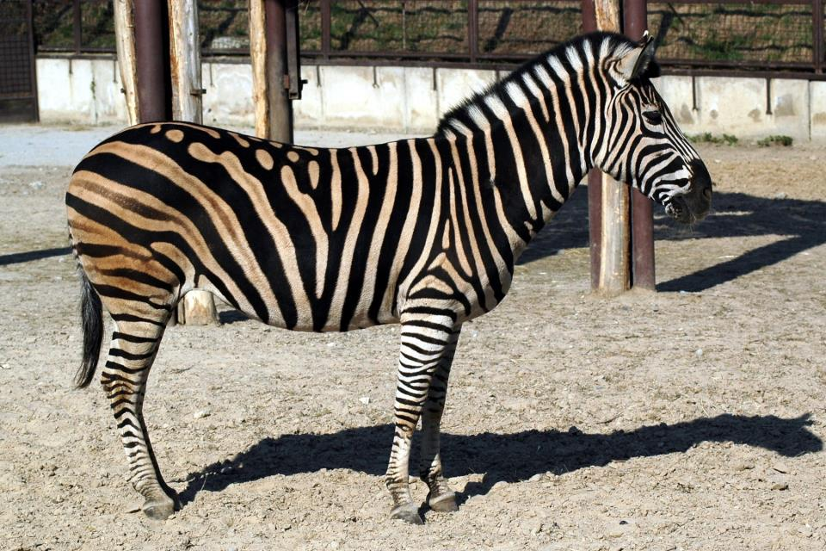
zebra

Slide 79
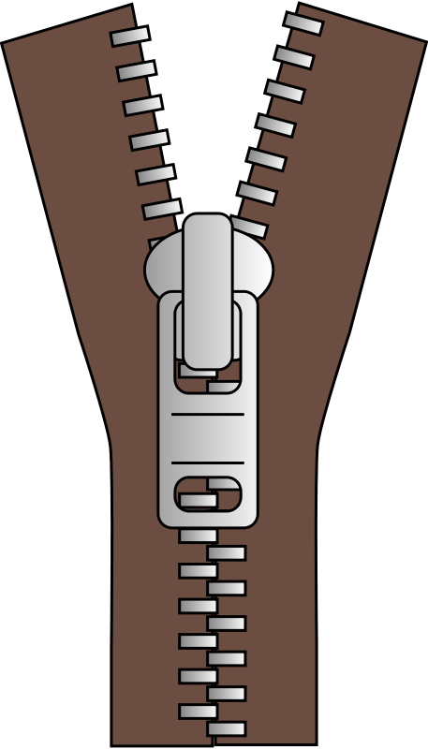
zipper

Slide 80
Picture Attributions
"Ant on leaf" by Luke Elstad - Own Work in MN. Licensed under Creative Commons Attribution 2.5 via Wikimedia Commons - http://commons.wikimedia.org/wiki/File:Ant_on_leaf.jpg#mediaviewer/File:Ant_on_leaf.jpg
"Red Apple" by Abhijit Tembhekar from Mumbai, India - Nikon D80 Apple. Licensed under Creative Commons Attribution 2.0 via Wikimedia Commons - http://commons.wikimedia.org/wiki/File:Red_Apple.jpg#mediaviewer/File:Red_Apple.jpg
"PikiWiki Israel 11327 Wildlife and Plants of Israel-Bat-003" by Original photo: אורן פלס Oren PelesDerivative work: User:MathKnight - File:PikiWiki Israel 11327 Wildlife and Plants of Israel.JPG by אורן פלס. Licensed under Creative Commons Attribution 2.5 via Wikimedia Commons - http://commons.wikimedia.org/wiki/File:PikiWiki_Israel_11327_Wildlife_and_Plants_of_Israel-Bat-003.jpg#mediaviewer/File:PikiWiki_Israel_11327_Wildlife_and_Plants_of_Israel-Bat-003.jpg
"Basketball" by Reisio - Own work. Licensed under Public domain via Wikimedia Commons - http://commons.wikimedia.org/wiki/File:Basketball.png#mediaviewer/File:Basketball.png
"Cat in Kautokeino" by Barasoaindarra - Own work. Licensed under Creative Commons Attribution-Share Alike 2.5 via Wikimedia Commons - http://commons.wikimedia.org/wiki/File:Cat_in_Kautokeino.jpg#mediaviewer/File:Cat_in_Kautokeino.jpg
"2001-10-23 NikonE880 dscn1906" by Valeriy Ovechkin - Own work. Licensed under Creative Commons Attribution-Share Alike 3.0 via Wikimedia Commons - http://commons.wikimedia.org/wiki/File:2001-10-23_NikonE880_dscn1906.jpg#mediaviewer/File:2001-10-23_NikonE880_dscn1906.jpg
"Polski Owczarek Podhalanski" by Marita Grasshoff - Own work. Licensed under Creative Commons Attribution-Share Alike 3.0 via Wikimedia Commons - http://commons.wikimedia.org/wiki/File:Polski_Owczarek_Podhalanski.jpg#mediaviewer/File:Polski_Owczarek_Podhalanski.jpg
"Mallard 080508" by Anton Holmquist Soasta - Own work. Licensed under Creative Commons Attribution-Share Alike 3.0 via Wikimedia Commons - http://commons.wikimedia.org/wiki/File:Mallard_080508.jpg#mediaviewer/File:Mallard_080508.jpg

Slide 81
"Egg" by Kacper "Kangel" Aniołek - Own work. Licensed under Creative Commons Attribution 2.5 via Wikimedia Commons - http://commons.wikimedia.org/wiki/File:Egg.jpg#mediaviewer/File:Egg.jpg
"Elephant near ndutu" by The author is nickandmel2006 on flickr - Originally from en.wikipedia; description page is/was here.. Licensed under Creative Commons Attribution-Share Alike 2.0 via Wikimedia Commons - http://commons.wikimedia.org/wiki/File:Elephant_near_ndutu.jpg#mediaviewer/File:Elephant_near_ndutu.jpg
"Red-eyed tree frog Lapa Rios" by Charlesjsharp - Own work. Licensed under Creative Commons Attribution-Share Alike 3.0 via Wikimedia Commons - http://commons.wikimedia.org/wiki/File:Red-eyed_tree_frog_Lapa_Rios.JPG#mediaviewer/File:Red-eyed_tree_frog_Lapa_Rios.JPG
"Peixe010eue" by Luis Miguel Bugallo Sánchez (Lmbuga)Copyright: GFDL (GNU Free Documentation License)Publicada por/Publish by: Luis Miguel Bugallo Sánchez - Galipedia, a wikipedia galega. Licensed under Creative Commons Attribution-Share Alike 3.0 via Wikimedia Commons - http://commons.wikimedia.org/wiki/File:Peixe010eue.jpg#mediaviewer/File:Peixe010eue.jpg
"Saanenziege". Licensed under Creative Commons Attribution-Share Alike 3.0 via Wikimedia Commons - http://commons.wikimedia.org/wiki/File:Saanenziege.jpg#mediaviewer/File:Saanenziege.jpg
"Male silverback Gorilla" by Raul654 - Own work. Licensed under Creative Commons Attribution-Share Alike 3.0 via Wikimedia Commons - http://commons.wikimedia.org/wiki/File:Male_silverback_Gorilla.JPG#mediaviewer/File:Male_silverback_Gorilla.JPG
"Felthat" by Ealdgyth - Own work. Licensed under Creative Commons Attribution 3.0 via Wikimedia Commons - http://commons.wikimedia.org/wiki/File:Felthat.jpg#mediaviewer/File:Felthat.jpg
"Chicken - melbourne show 2005". Licensed under GNU Free Documentation License 1.2 via Wikimedia Commons - http://commons.wikimedia.org/wiki/File:Chicken_-_melbourne_show_2005.jpg#mediaviewer/File:Chicken_-_melbourne_show_2005.jpg
"Igloo outside". Licensed under Creative Commons Attribution-Share Alike 3.0 via Wikimedia Commons - http://commons.wikimedia.org/wiki/File:Igloo_outside.jpg#mediaviewer/File:Igloo_outside.jpg
"Adult citrus root weevil, Diaprepes abbreviatus" by Keith Weller - This image was released by the Agricultural Research Service, the research agency of the United States Department of Agriculture, with the ID K7456-1 (next).This tag does not indicate the copyright status of the attached work. A normal copyright tag is still required. See Commons:Licensing for more information.English | français | македонски | +/−. Licensed under Public domain via Wikimedia Commons - http://commons.wikimedia.org/wiki/File:Adult_citrus_root_weevil,_Diaprepes_abbreviatus.jpg#mediaviewer/File:Adult_citrus_root_weevil,_Diaprepes_abbreviatus.jpg

Slide 82
http://openclipart.org/detail/5257/jug-by-biswajyotim-5257
"Orange juice 1" by Agricultural Research Service - [1]. Licensed under Public domain via Wikimedia Commons - http://commons.wikimedia.org/wiki/File:Orange_juice_1.jpg#mediaviewer/File:Orange_juice_1.jpg
"Dreiecksdrachen Bunt 02" by Huhu Uet - Own work. Licensed under Creative Commons Attribution 3.0 via Wikimedia Commons - http://commons.wikimedia.org/wiki/File:Dreiecksdrachen_Bunt_02.jpg#mediaviewer/File:Dreiecksdrachen_Bunt_02.jpg
http://openclipart.org/detail/191744/key-yellow-by-gerhard-tinned-191744
"Magnolia x soulangeana Rogów" by Crusier - Own work. Licensed under Creative Commons Attribution-Share Alike 3.0 via Wikimedia Commons - http://commons.wikimedia.org/wiki/File:Magnolia_x_soulangeana_Rog%C3%B3w.JPG#mediaviewer/File:Magnolia_x_soulangeana_Rog%C3%B3w.JPG
"Dumdums". Licensed under Creative Commons Attribution-Share Alike 3.0 via Wikimedia Commons - http://commons.wikimedia.org/wiki/File:Dumdums.jpg#mediaviewer/File:Dumdums.jpg
"House mouse" by unknown - http://www.nigms.nih.gov/NR/rdonlyres/89908011-CCC4-4A12-BC08-BC64FCA62DF8/0/mouse.jpg at http://www.nigms.nih.gov/Initiatives/Models/ (formerly at http://www.nigms.nih.gov/research/modelorganisms.html). Licensed under Public domain via Wikimedia Commons - http://commons.wikimedia.org/wiki/File:House_mouse.jpg#mediaviewer/File:House_mouse.jpg
http://openclipart.org/image/800px/svg_to_png/172847/mermaid_paulliu.png
"InstantNoodles" by Kcdtsg - Own work. Licensed under Public domain via Wikimedia Commons - http://commons.wikimedia.org/wiki/File:InstantNoodles.JPG#mediaviewer/File:InstantNoodles.JPG
"Amselnest lokilech" by Lokilech - Own work. Licensed under Creative Commons Attribution-Share Alike 3.0 via Wikimedia Commons - http://commons.wikimedia.org/wiki/File:Amselnest_lokilech.jpg#mediaviewer/File:Amselnest_lokilech.jpg
"Citrus sinensis". Licensed under Public domain via Wikimedia Commons - http://commons.wikimedia.org/wiki/File:Citrus_sinensis.jpg#mediaviewer/File:Citrus_sinensis.jpg
http://openclipart.org/detail/175028/little-red-octopus-by-estitic-175028

Slide 83
"Emperor-walk hg" by Hannes Grobe/AWI - Own work. Licensed under Creative Commons Attribution 3.0 via Wikimedia Commons - http://commons.wikimedia.org/wiki/File:Emperor-walk_hg.jpg#mediaviewer/File:Emperor-walk_hg.jpg
"Pumpkin 252 - Evan Swigart" by Evan Swigart from Chicago, USA - Pumpkin 252. Licensed under Creative Commons Attribution 2.0 via Wikimedia Commons - http://commons.wikimedia.org/wiki/File:Pumpkin_252_-_Evan_Swigart.jpg#mediaviewer/File:Pumpkin_252_-_Evan_Swigart.jpg
http://openclipart.org/detail/76513/queens-head-by-gammillian
http://openclipart.org/detail/64777/quilt-by-deluge
"Bunny in zoo cropped" by Bunny_in_zoo.jpg: Tiia Montoderivative work: Anna Frodesiak - This file was derived from:Bunny_in_zoo.jpg. Licensed under Creative Commons Attribution-Share Alike 3.0 via Wikimedia Commons - http://commons.wikimedia.org/wiki/File:Bunny_in_zoo_cropped.jpg#mediaviewer/File:Bunny_in_zoo_cropped.jpg
http://openclipart.org/detail/139759/r-is-for-rocket-by-marauder
http://openclipart.org/detail/174888/snake-by-artbejo-174888
http://openclipart.org/detail/14693/emblem-star-by-rocket000
"Lightmatter tortoise". Licensed under Creative Commons Attribution 1.0 via Wikimedia Commons - http://commons.wikimedia.org/wiki/File:Lightmatter_tortoise.jpg#mediaviewer/File:Lightmatter_tortoise.jpg
"Tomato". Licensed under Creative Commons Attribution-Share Alike 3.0 via Wikimedia Commons - http://commons.wikimedia.org/wiki/File:Tomato.jpg#mediaviewer/File:Tomato.jpg
"Regnhlíf" by Camera: Sternenlaus, Photo: birdy - selfmade by see authors. Licensed under Creative Commons Attribution-Share Alike 3.0 via Wikimedia Commons - http://commons.wikimedia.org/wiki/File:Regnhl%C3%ADf.jpg#mediaviewer/File:Regnhl%C3%ADf.jpg
"Blaue Rispe nach Riemerschmid Vase 19,5cm" by Kaolin - Own work. Licensed under Public domain via Wikimedia Commons - http://commons.wikimedia.org/wiki/File:Blaue_Rispe_nach_Riemerschmid_Vase_19,5cm.JPG#mediaviewer/File:Blaue_Rispe_nach_Riemerschmid_Vase_19,5cm.JPG
http://openclipart.org/detail/64051/volcano-by-j_alves
http://openclipart.org/detail/82867/worm-by-neo1012

Slide 84
"Hanhart Pioneer Mk I 714 210 021" by Malaise - Own work. Licensed under Creative Commons Attribution-Share Alike 3.0 via Wikimedia Commons - http://commons.wikimedia.org/wiki/File:Hanhart_Pioneer_Mk_I_714_210_021.jpg#mediaviewer/File:Hanhart_Pioneer_Mk_I_714_210_021.jpg
"Swift Fox" by en:User:Cburnett - Own work. Licensed under Creative Commons Attribution-Share Alike 3.0 via Wikimedia Commons - http://commons.wikimedia.org/wiki/File:Swift_Fox.jpg#mediaviewer/File:Swift_Fox.jpg
"MOVINGBOX" by HarrisonB at en.wikipedia - Own workTransferred from en.wikipedia. Licensed under Public domain via Wikimedia Commons - http://commons.wikimedia.org/wiki/File:MOVINGBOX.JPG#mediaviewer/File:MOVINGBOX.JPG
http://openclipart.org/detail/121561/yo-yo-by-myhtech
"Zebra 02" by Stano Novak - Own work. Licensed under Creative Commons Attribution 2.5 via Wikimedia Commons - http://commons.wikimedia.org/wiki/File:Zebra_02.jpg#mediaviewer/File:Zebra_02.jpg
http://openclipart.org/detail/169991/zipper-by-deluge

